Slide 1
Reingold-Tilford Layout -radial layout
NAME : wang guangyu
Sid:201620130145

Slide 2
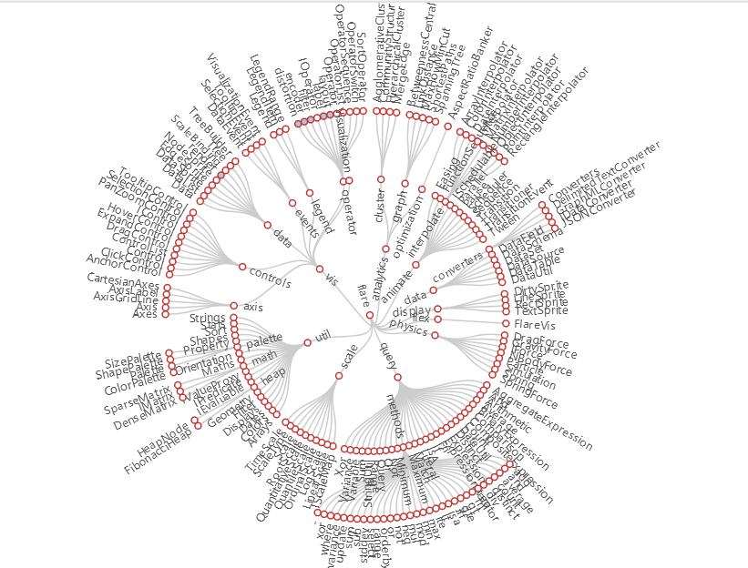
Reingold-Tilford Layout Tree

Slide 3
Reingold-Tilford Layout Algorithm
Standard:
-All nodes are layered according to the hierarchy in the tree
-Avoid intersecting edges
-Similar subtrees are expressed in similar (or mirrored)
-Compact expression
Basic method:
-Bottom-up recursive calculation
-For each parent node, make sure the subtree is fully drawn
-Packing subtree as tight as possible
-Place the parent node in the center of the subtree

Slide 4
Reingold-Tilford Layout Algorithm
Recursive calculation from bottom to top:
-Post-order traversal of the tree
-In this way, for the parent node, when traversing, you can ensure that the left and right subtrees have been laid out.
For each parent node, make sure the subtree is fully drawn:
-This kind of drawing order can ensure that the subtrees with the same structure have the same representation - because the rendering process of each subtree is not affected by the elements outside the subtree.

Slide 5
Reingold-Tilford Layout Algorithm
Packing subtree as tight as possible:
-For each node, calculate the right contour of the left and right subtrees and the left contour of the right subtree, and adjust the position of the left and right subtrees until the two just shift a predetermined threshold r
Then place the parent node in the center of the left and right subtrees
Can be extended to multi-fork trees

